Slide 1
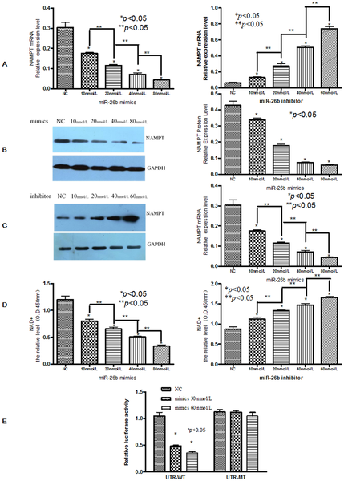

Figure 2. The effects of miR-26b on Nampt expression.
Zhang C, Tong J, Huang G (2013) Nicotinamide Phosphoribosyl Transferase (Nampt) Is a Target of MicroRNA-26b in Colorectal Cancer Cells. PLOS ONE 8(7): e69963. https://doi.org/10.1371/journal.pone.0069963
https://journals.plos.org/plosone/article?id=10.1371/journal.pone.0069963

