Slide 1
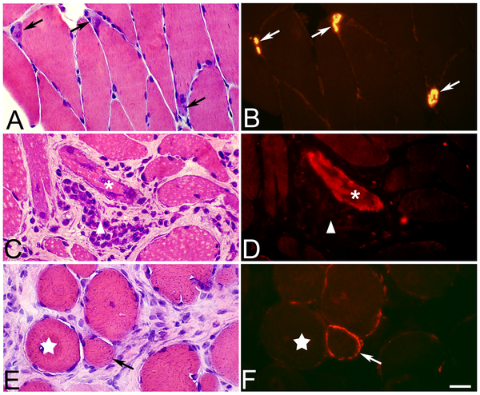

Figure 8. AChE reactivity pattern.
Song Y, Forsgren S, Yu J, Lorentzon R, Stål PS (2012) Effects on Contralateral Muscles after Unilateral Electrical Muscle Stimulation and Exercise. PLOS ONE 7(12): e52230. https://doi.org/10.1371/journal.pone.0052230
https://journals.plos.org/plosone/article?id=10.1371/journal.pone.0052230

