Slide 1
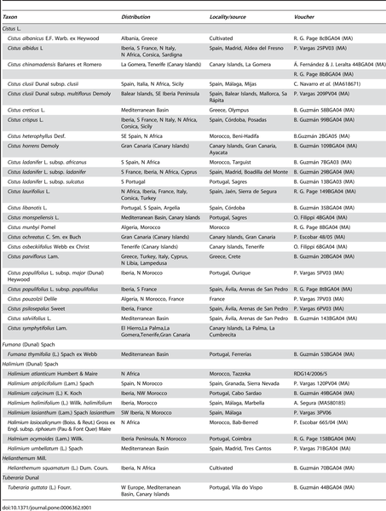

Table 1. List of species used in the phylogenetic analysis.
Guzmán B, Lledó MD, Vargas P (2009) Adaptive Radiation in Mediterranean Cistus (Cistaceae). PLOS ONE 4(7): e6362. https://doi.org/10.1371/journal.pone.0006362
https://journals.plos.org/plosone/article?id=10.1371/journal.pone.0006362

