Slide 1
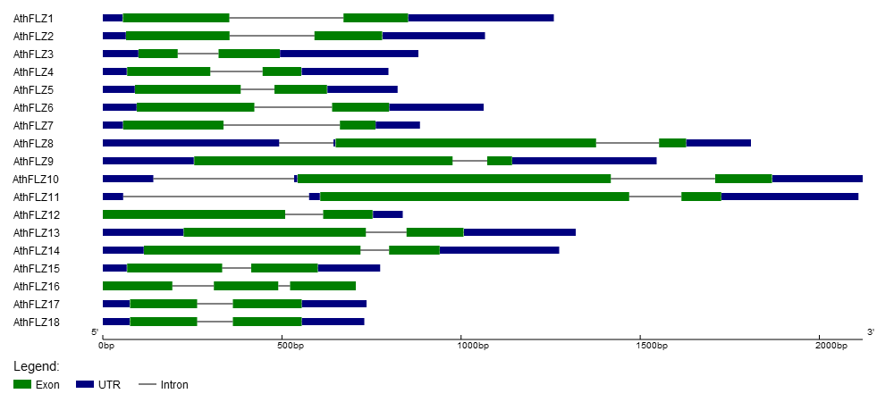
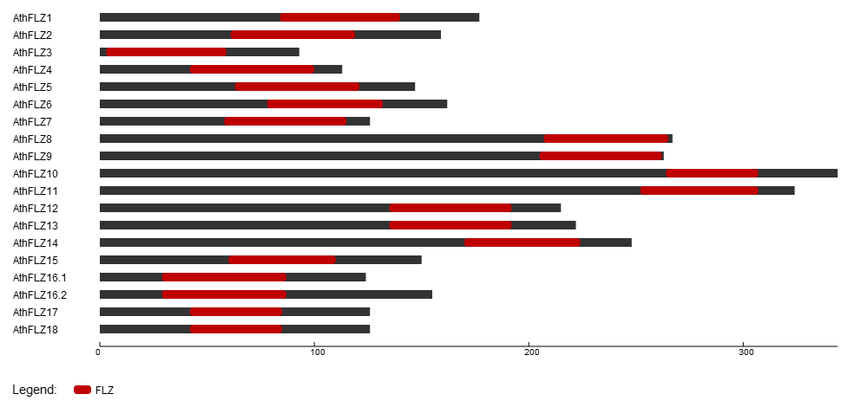
A
B
C
S5 Fig. Gene structure, splice variants and domain organization of Arabidopsis thaliana FLZ family.
(A) Gene structure of 18 A. thaliana FLZ genes showing exon, intron and UTR organization. (B) Alternative transcripts of A. thaliana FLZ genes .(C) Domain organization of A. thaliana FLZ proteins.

