Slide 1
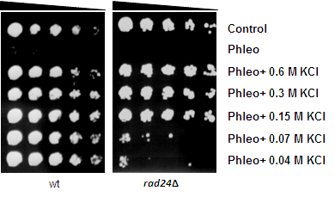
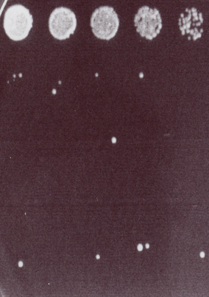
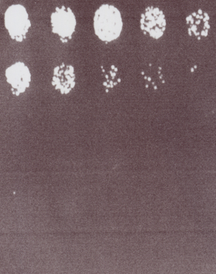
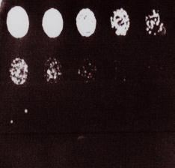
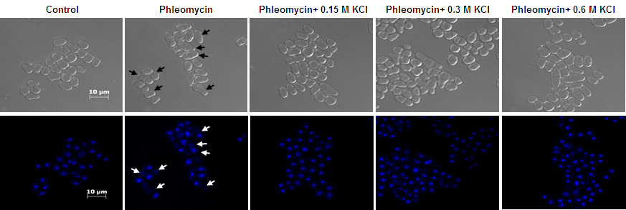
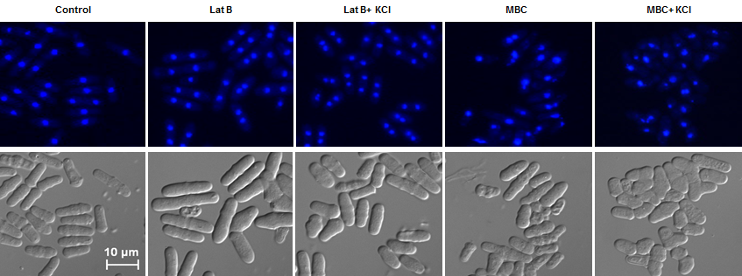
Additional file S1
A
B
C
Control
Control
Control
Phleo 10μg/ ml
Phleo 1µg/ ml
G418 5 µg/ ml
Phleo+ 0.60M KCl
Phleo 2.5µg/ ml
G418 10 µg/ ml
Phleo+ 0.30M KCl
Phleo 5µg/ ml
G418 25 µg/ ml
Phleo+ 0.15M KCl
Phleo 7.5µg/ ml
G418 37.5 µg/ ml
Phleo+ 0.07M KCl
Phleo+ 0.04M KCl
Phleo 10µg/ ml
G418 50 µg/ ml
wt
rad24Δ
D
E
Control
Control
Hygro 5µg/ml
Phleo 10μg/ml
Hygro 10µg/ml
0.6M KCl>Phleo 10μg/ml
Hygro 25µg/ml
F
Control
Phleo 10μg/ml
Phleo+ 0.15M KCl
Phleo+ 0.30M KCl
Phleo+ 0.60M KCl
rad24Δ
G
Control
Lat B 10μM
Lat B+ 0.6M KCl
MBC 50μg/ml
MBC+ 0.6M KCl

