Slide 1
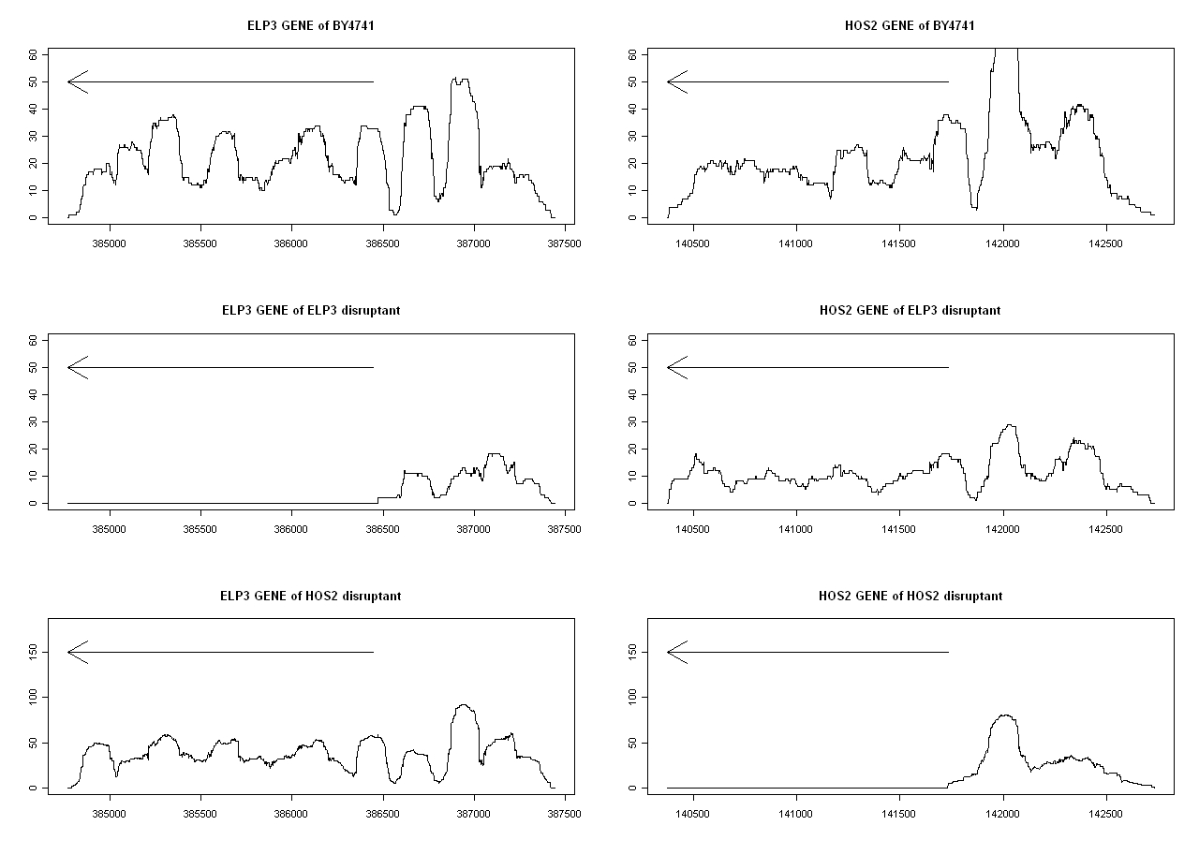
Supplementary Fig. S1

