Slide 1
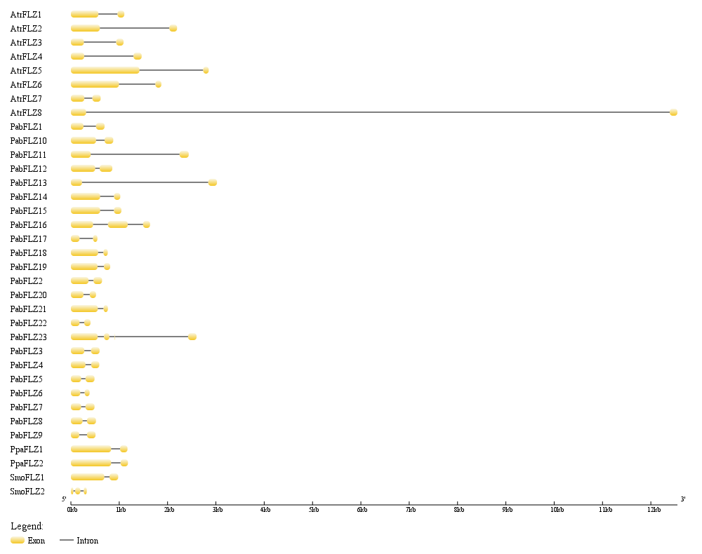
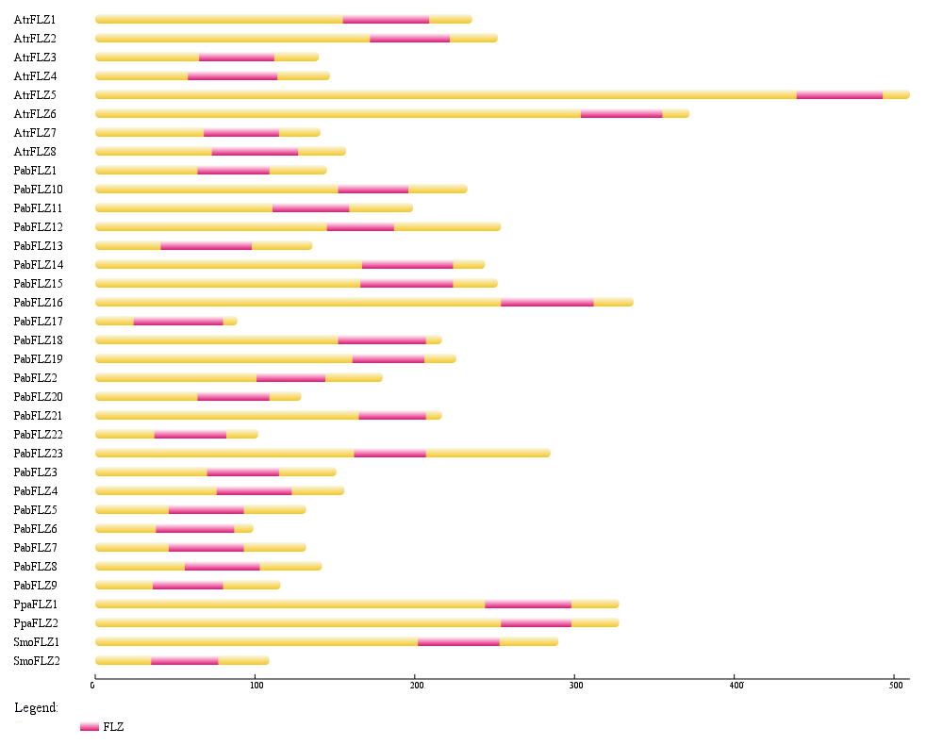
A
B
S4 Fig. Exon-intron structure and protein domain organization of FLZ family genes from Physcomitrella patens, Selaginella moellendorffii, Picea abies and Amborella trichopoda.
(A) Exon–intron structure of FLZ genes and (B) domain organization of FLZ proteins of P. patens, S. moellendorffii, P. abies and A. trichopoda.

