Slide 1
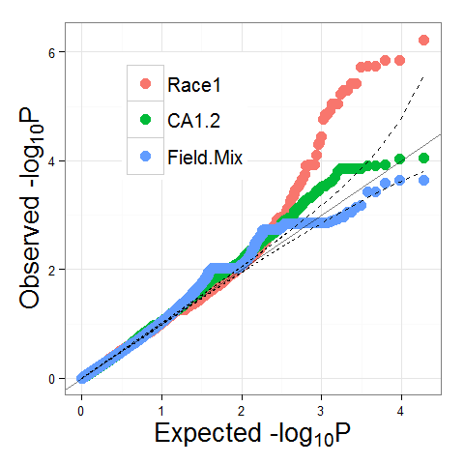
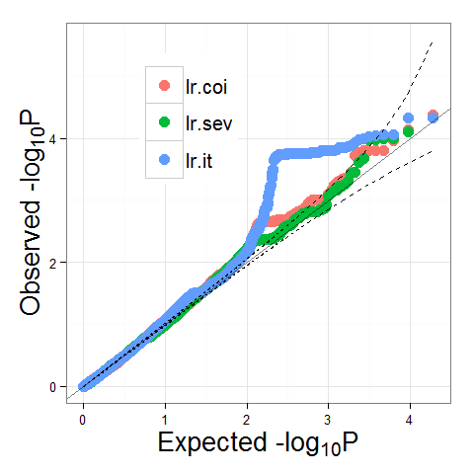
Race.Mix
Fig. S3 QQ plots for seedling and field traits

