Slide 1
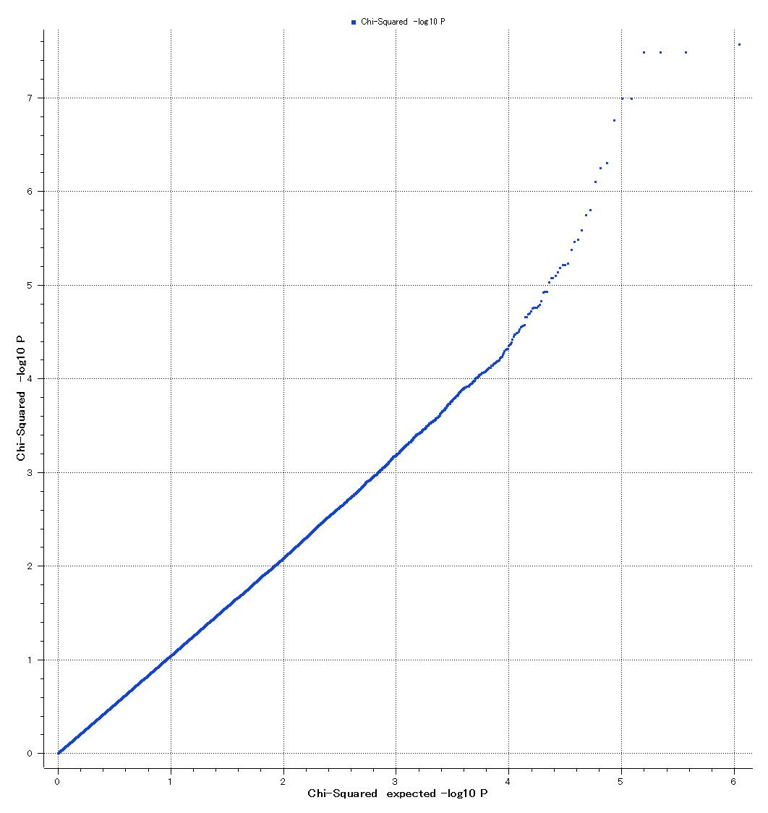
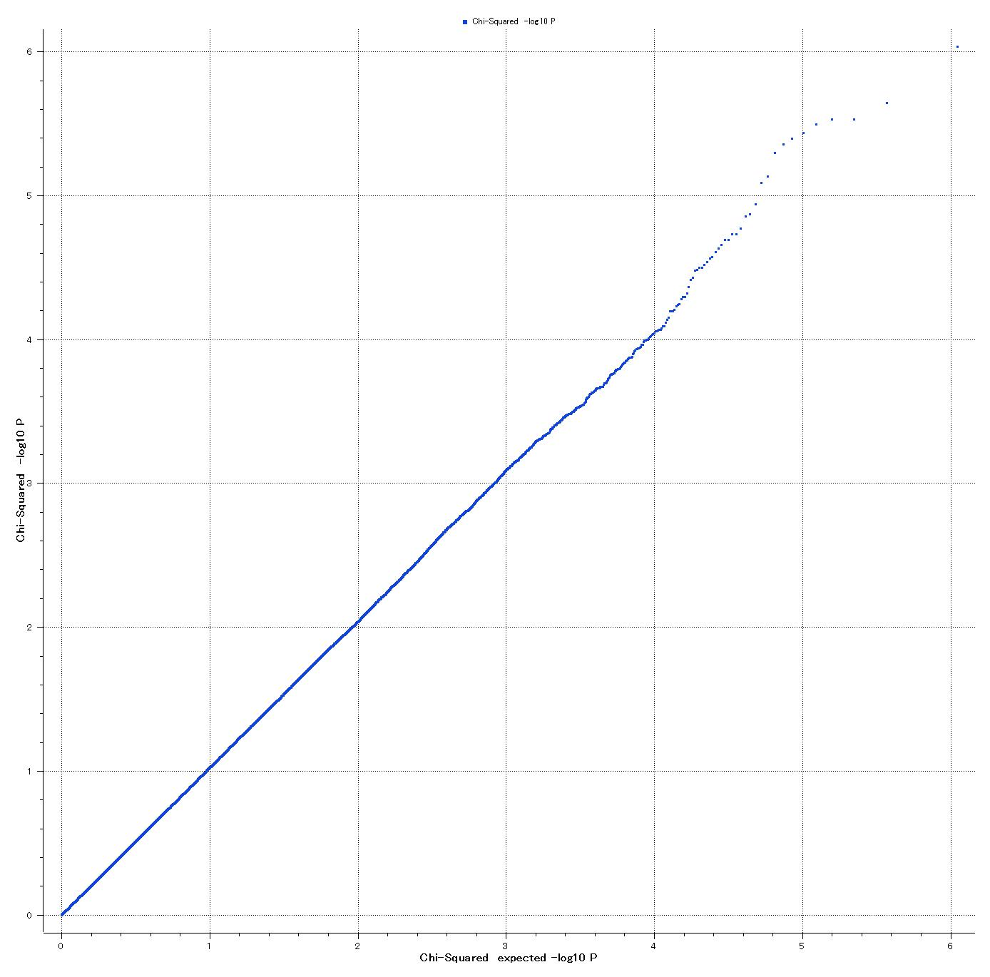
a
b
6
7
5
6
5
4
4
3
Chi-Squared –log10 P
Chi-Squared –log10 P
3
2
2
1
1
0
0
0
1
2
3
4
5
6
0
1
2
3
4
5
6
Chi-Squared expected –log10 P
Chi-Squared expected –log10 P

