Slide 1
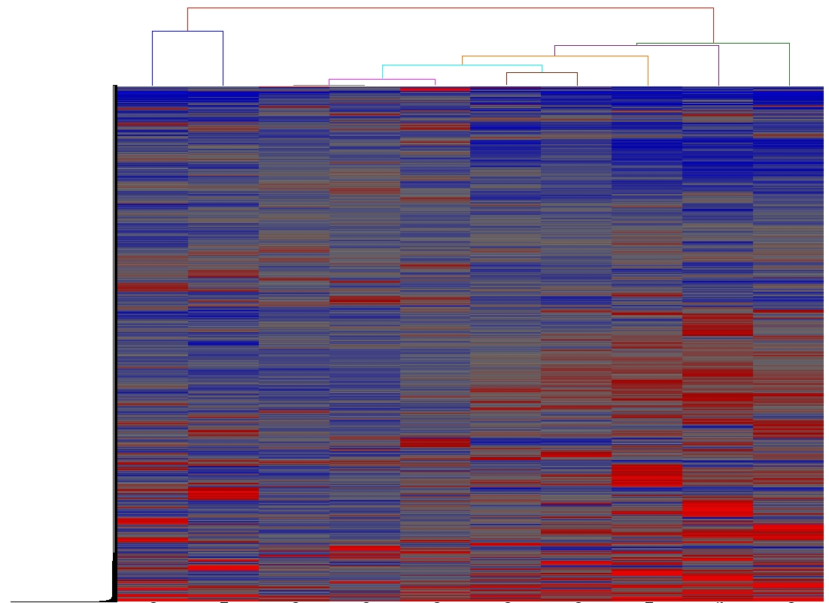
Table 1
Gene list
SC3
SC2
CAF18
HPNE
CAF13
CAF11
CAF12
CAF16
CAF15
CAF19

