Slide 1
Table S1. Primers used for PCR and sequencing in this study
Genes | Primer sequences 5′–3′
 | Forward | Reverse
PHE1, PHE2 | ATGCCTACACGTAAkGGTGrA | ATTGrTGATGTTAGGAGCAC
 | TATAAACCATCCTCCTyATkCTAA | CACTTCACTCGAAATAyATCC
At1g59920, At1g59930, At5g35120 | TCAATCACATGCGTACACGTAG | GATGTTAGGmGCACAArCATCArC
 | AAAACCCTAATGGGTyAwAGCA | AAGGATTATTGGTGrTGTTAGg
 | TGCGTACACGTAGGArTGGA
AGL34, AGL36, AGL90 | ATAGATArTAATGAATTACCTGGTC | CACAAATwCAAACAAyTGAACAC
 | TGTTATTTAGAATTAATkAGTCCAC | TGATTAGAGATTrTTGTTGA
 | AAGCTATCTTTGATAGCTAATG
 | CAACTCTrTGTGGTGTCCAAG
AGL86, AGL92 | TTGGGCmAAGAAACTAAACA | ArCTrACTTAAAGGTAAAACCT
 | CTTAGwCATAGCTwTAATTAGTGGC | AGGCATGTGAsCGGTGGwAGTA
AGL35 | TTGAACTGAGATAAATTTTsCTT | AACAAACAGAACTmAAAyAATAAC
AGL80 | ATGACrAGAAAGAAAGTGAAAs | TTGmTCAGGATGGTTCATCA
 |  | AACCATrTGTTATTGGTAAkA
AGL46 | AAGCTArCTTACATwTyCAATGAT | AAAyTCATCCTGAAACAyAAT
AGL45 | TGGAAAGTwCTTTTAyTGTTCTCAT | CGATAATGTAAAGATGGAGAAA
 | ATGACGAGGAAGAAGyTAAACCTATC | ATAATACAAGGAACAAAACCAArAC
 |  | AGTTGTTrTmATCCATCAAAGGA

Slide 2
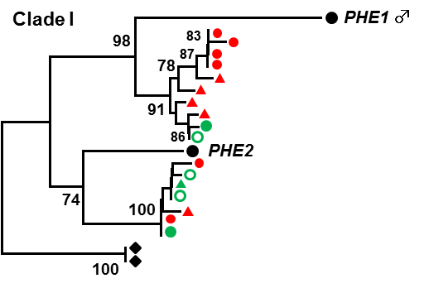
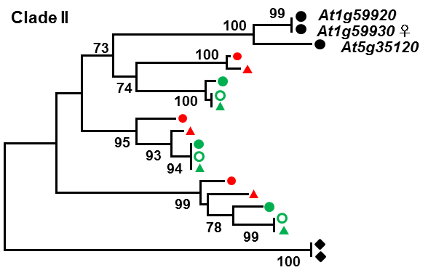
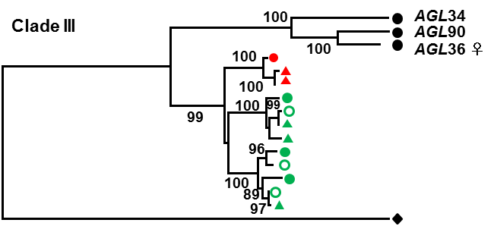
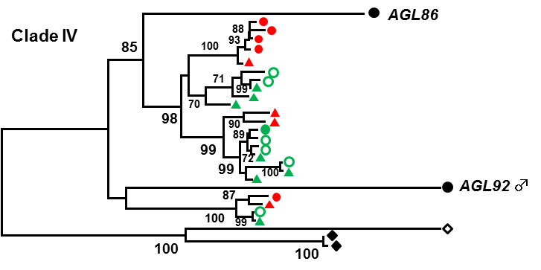
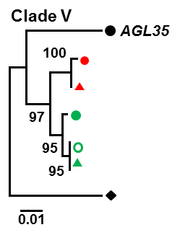
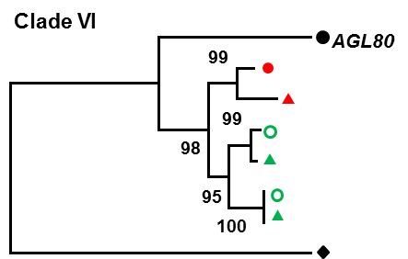
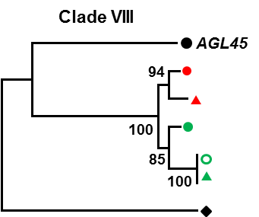
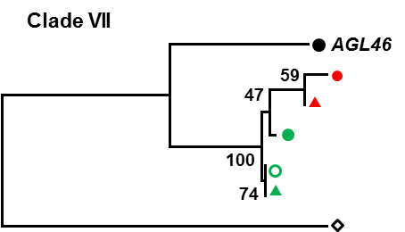
A. thaliana
A. lyrata ssp. lyrata
A. lyrata ssp. petraea
A. halleri ssp. gemmifera
A. halleri ssp. halleri
A. halleri ssp. tatrica
C. wallichii
T. glabra
Figure S1. Neighbor-joining trees of clades I–VIII.
Phylogenetic relationship was estimated with the Jukes and Cantor distance. Bootstrap values (%) were estimated by 500 replications for each clade and shown at corresponding nodes. All trees are shown in a same scale. A distance bar is shown at the bottom. Sequence of each gene excluding alignment gaps or indels was used for estimations. Black circle; A. thaliana, red circle; A. lyrata ssp. lyrata, red triangle; A. lyrata ssp. petraea, green circle; A. halleri ssp. gemmifera, open green circle; A. halleri ssp. halleri, green triangle circle; A. halleri ssp. tatrica, empty diamond; C. wallichii, black diamond; T. glabra.

Slide 3
1
2
3
4
5
6
7
8
L5
L20
L11
L4
L1
L12
L10
L17
L13
5Kb
L3
L18
1Kb
L19
L14
L2
L15
L6
L7
L8
L1 ~ L20 represent homologous sequences.
location of homologs
L9
tandemly duplicated sequence
Figure S2. Location of the homologs in the genome of A. lyrata ssp. lyrata.
Each line represents large scaffolds covering the majority of each of the 8 chromosomes of A. lyrata. The numbered boxes from L1 to L20 representing homologous sequences are identical with sequences in Fig. 4. Tandem duplicated sequences are shown in scaffold 1 and 2.

