Slide 1
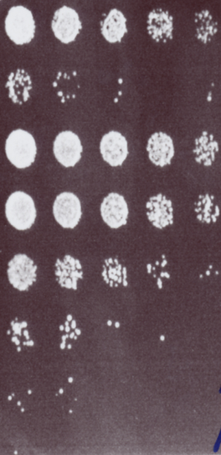
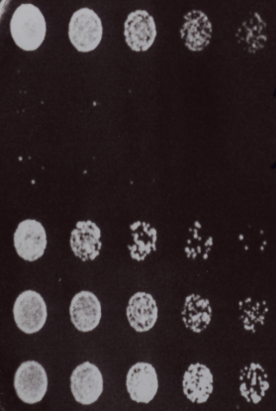
Additional file S4
A
B
Control
Control
Amphotericin B 1.0µg/ml
Caspofungin 1.0µg/ ml
Amphotericin B 1.0µg/ml+ 0.03M KCl
Caspofungin + 0.12M Sorbitol
Amphotericin B 1.0µg/ml+ 0.06M KCl
Caspofungin + 1.2M Sorbitol
Amphotericin B 1.0µg/ml+ 0.15M KCl
0.12M Sorbitol
Amphotericin B 1.0µg/ml+ 0.30M KCl
1.2M Sorbitol
Amphotericin B 1.0µg/ml+ 0.45M KCl
Amphotericin B 1.0µg/ml+ 0.60M KCl

