Slide 1
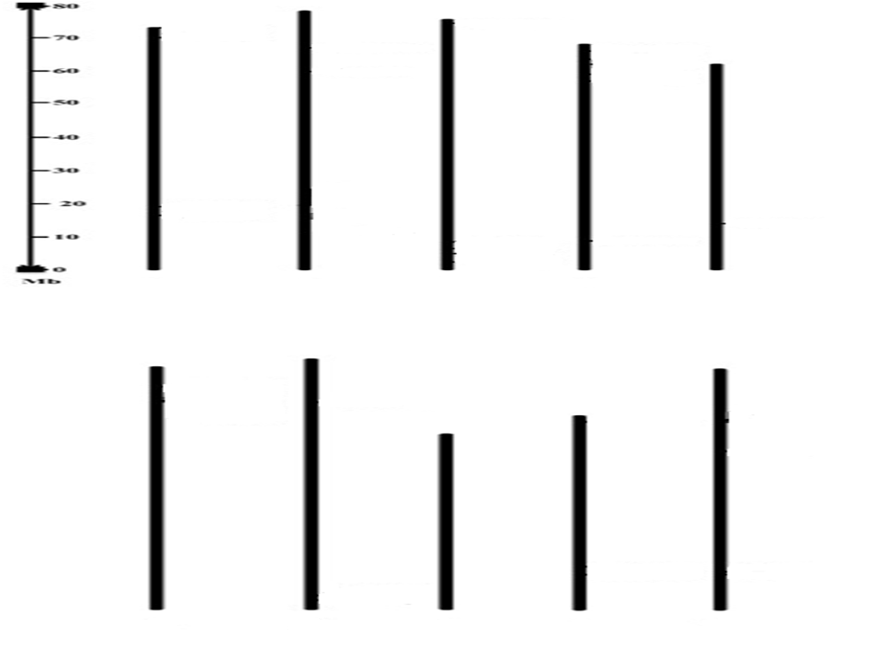
SbNFY –B7
SbNFY –A3
SbNFY –B6
SbNFY –A5
SbNFY –B5
SbNFY –A6
SbNFY –C3
SbNFY –B3
SbNFY –A2
SbNFY –B9
SbNFY –C6
SbNFY –C4
SbNFY –B8
SbNFY -B1
SbNFY -A1
SbNFY –B2
SbNFY –B4
SbNFY –C2
SbNFY –A4
SbNFY –C5
SbNFY -C1
1 2 3 4 5
SbNFY –C11
SbNFY –C15
SbNFY –C7
SbNFY –B12
SbNFY –B16
SbNFY –B11
SbNFY –A8
SbNFY –C14
SbNFY –A7
SbNFY –B15
SbNFY –B19
SbNFY –C13
SbNFY –B14
SbNFY –C10
SbNFY –B13
SbNFY –C9
SbNFY –C12
SbNFY –B18
SbNFY –C8
SbNFY –B17
SbNFY –B10
6 7 8 9 10
S6 Fig. Gene duplications of SbNFYs

