Slide 1
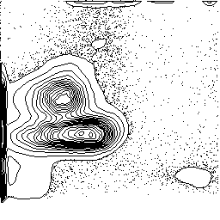
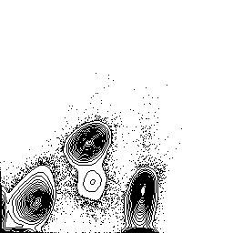
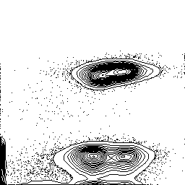
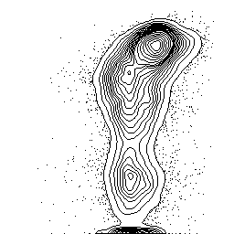
AC
Figure S1
(No. 32)
1000
10
4
92.2%
800
10
3
FSC
600
CD14
10
2
400
200
10
1
67.9%
0
10
0
10
0
10
1
10
2
10
3
10
4
10
0
10
1
10
2
10
3
10
4
PI
CD4
10
4
10
4
50.7%
48.0%
10
3
H (CD3^{high}CD7^{high})
10
3
CD4
10
2
31.8%
CD7
D (CD3^{dim}CD7^{dim})
10
1
10
2
10
0
1
L (CD3^{dim}CD7^{low})
10
0
10
1
10
2
10
3
10
4
10
16.8%
CD3
10
0
10
0
10
1
10
2
10
3
10
4
CD3

