Slide 1
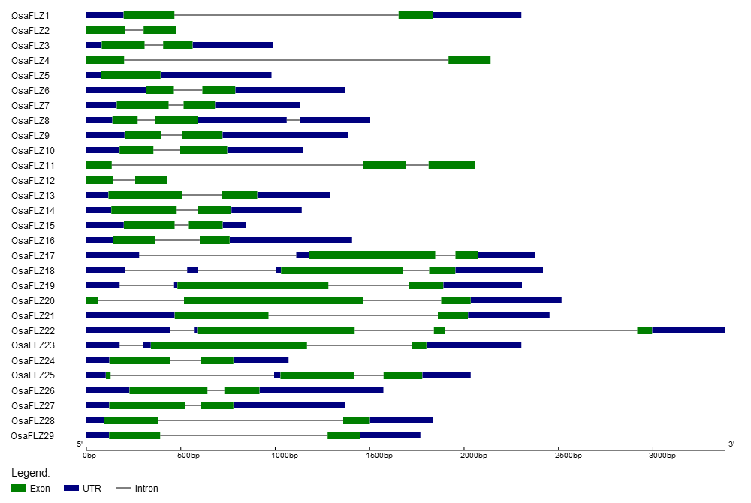
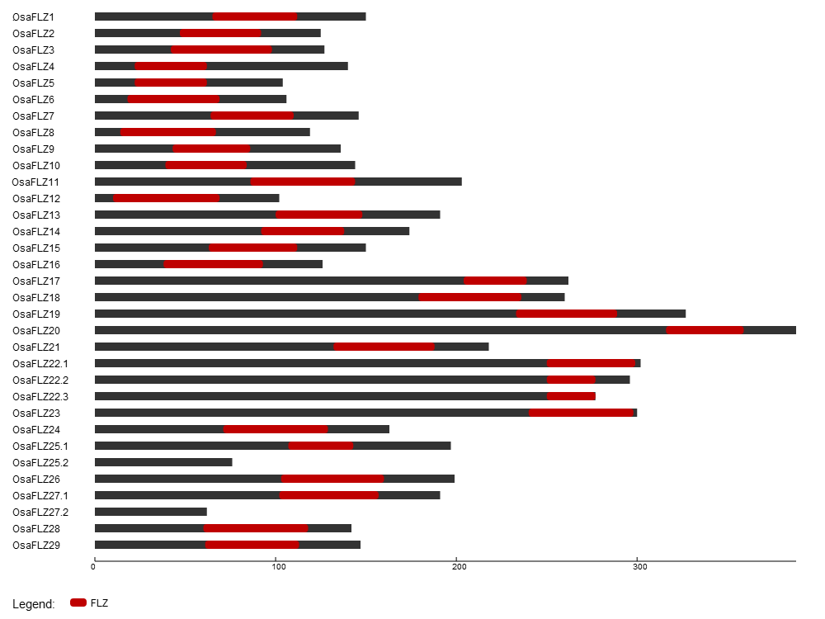
A
B
C
S7 Fig. Gene structure, splice variants and domain organization of Oryza sativa FLZ family.
(A) Gene structure of 29 O. sativa FLZ genes showing exon, intron and UTR organization. (B) Alternative transcripts of O. sativa FLZ genes .(C) Domain organization of 33 O. sativa FLZ proteins.

