Slide 1
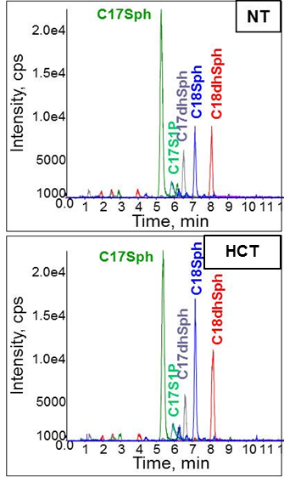
Supplementary Figure 1
B
C
0 0.3 1 3 10 30 DHS (µM)
0 1 2 4 8 24 CXM (hr)
IB: Nrf2
IB: SK1
A
IB: TBP
IB: β-actin
0 0.1 0.3 1 3 10 DMS (µM)
0 1 2 4 8 24 CXM (hr) + SKI-II
IB: Nrf2
IB: SK1
IB: TBP
0 0.1 0.3 1 3 10 SK1-I (µM)
IB: β-actin
IB: Nrf2
SKI-II(μM)
IB: β-actin
0 0.1 0.3 1 3 10 FTY720 (µM)
IB: Nrf2
IB: β-actin
F
D
E
RO SK1 SK2 SK1/2 siRNA
IB: Nrf2
IB: SK1
IB: SK2
IB: β-actin
SKI-II
SKI-II(μM)
G
SKI-II(1μM)

