Slide 1
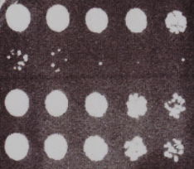
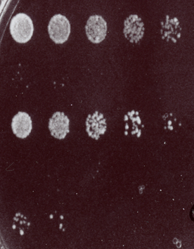
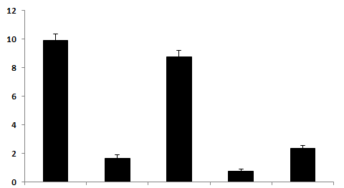
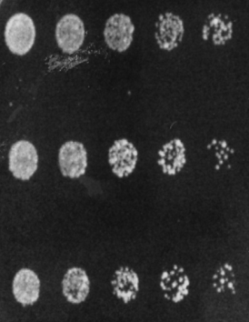
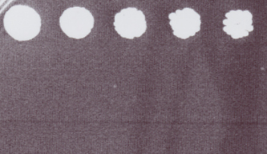
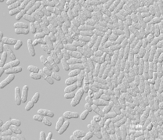
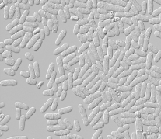
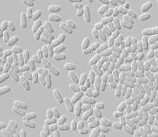
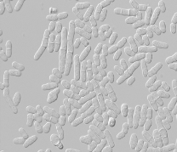
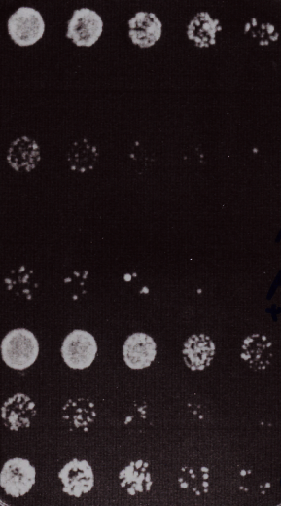
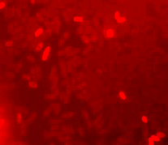
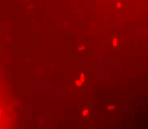
A
B
C
Control
Control
Control
0.6M RbCl
Phleo
1 mM CdCl₂
Phleo
NH₄Cl (250nM)+ Phleo
1 mM CdCl₂ + KCl
Phleo+ 0.038M
NH₄Cl (500nM)+ Phleo
2 mM CdCl₂
Phleo+ 0.075M
2 mM CdCl₂ + KCl
Phleo+ 0.150M
E
Phleo+ 0.300M
Phleo+ 0.600M
D
Control
Absorbance OD₆₀₀
1mM CdCl₂
1mM CdCl₂ + NaCl
2mM CdCl₂
2mM CdCl₂ + NaCl
Control
Phleo
Phleo+
0.6M KCl
Phleo+
0.6M NaCl
Phleo+
0.6M RbCl
F
Control
H
Doxorubicin+ KCl
Doxorubicin+ Sorbitol
0.4% Acetic acid
Control
Doxorubicin
0.4% Acetic acid+ KCl
DIC
G
Control
Doxorubicin
Phleomycin 10 µg/ml
0.2% Acetic acid
Phleomycin + Acetic acid
Phleomycin + Acetic acid+ 0.6M KCl
0.4% Lactic acid
wt
Phleomycin + Lactic acid
Phleomycin + Lactic acid+ KCl
Additional file S2

