Slide 1
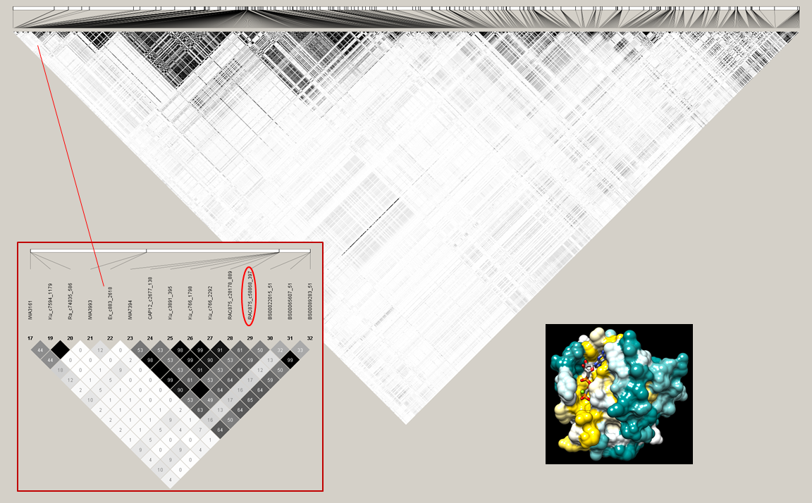
IWB59410 (syn. RAC875_c58868_397) possibly associated with a rabf (ras) protein involved in rust resistance
Fig. S5 Haploview of 4A chromosome LD patterns and the location of QLr.umn-4AS

