Slide 1
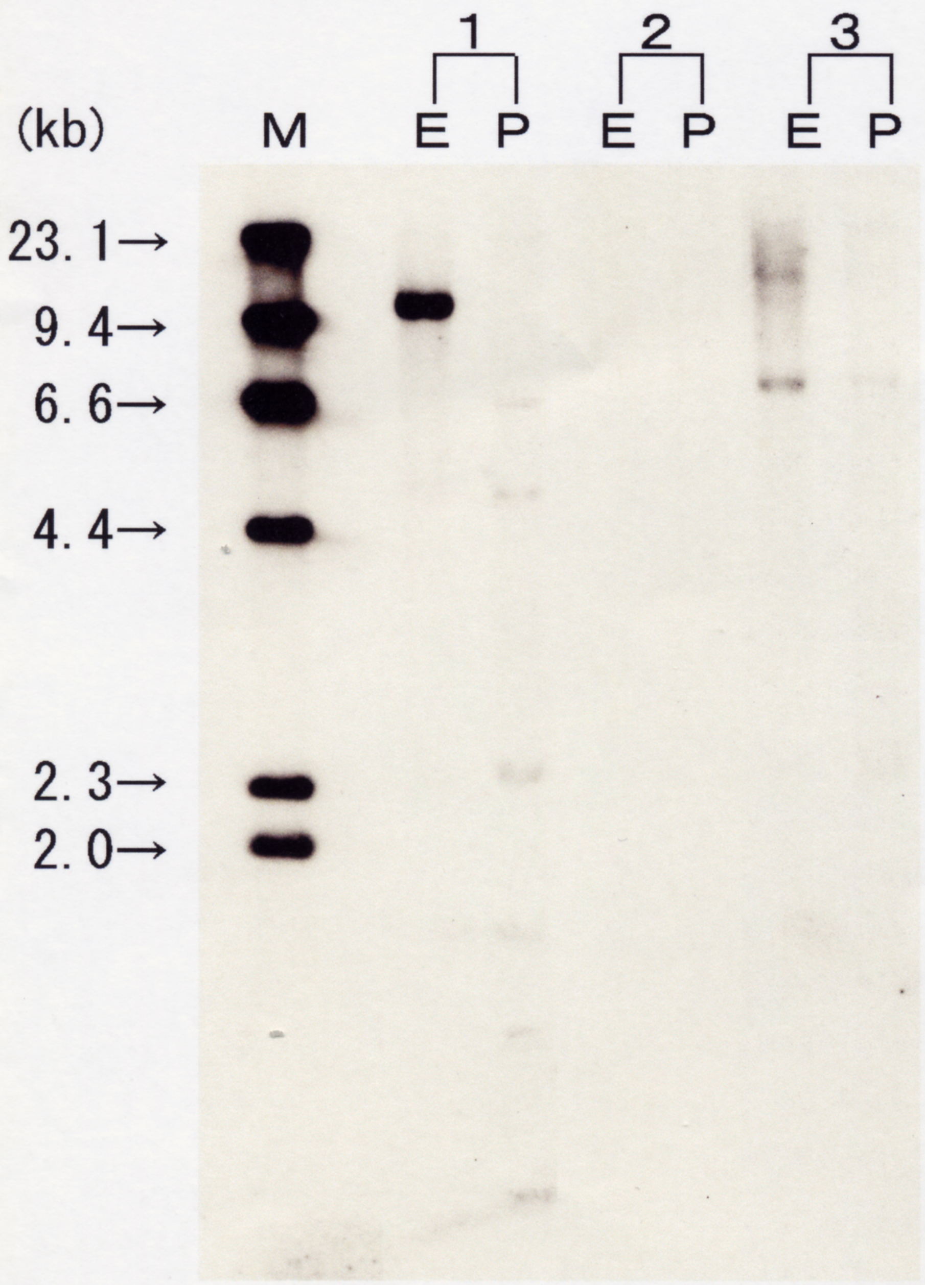
Figure S3
Negative control
Positive control
AC (No.34)
Marker (λDNA/HindIII )
E: EcoR1 digestion
P: Pst1 digestion

