Slide 1
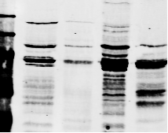
Figure S1
Normoxia Hypoxia
Trypsin - + - +
PKA
TOM20
SDHA

