Slide 1
S3 File
The quality of assembled sequences as a function of sequencing depth for all Illumina assemblies. The units for “Assembly Quality” are Normalized Bit Score (BS, maximum of 2) and the units of “Sequence Depth” are Sequenced Fragments/bp (SFB). The number printed in the plot area is the number of assembled sequences with normalized Bit Score above 1.5. A BS of 1.5 is an arbitrary threshold, yet represents long and accurate assemblies, and is used to illustrate the difference in the high density region seen in most plots near BS 1.75-2. For instance, a transcript that was reconstructed to 75% of the reference cDNA length with no errors would result in an alignment with a BS of 1.5. Since the rate of base call errors, alignment gaps and Type II errors are very low, the BS reports primarily alignment length.

Slide 2
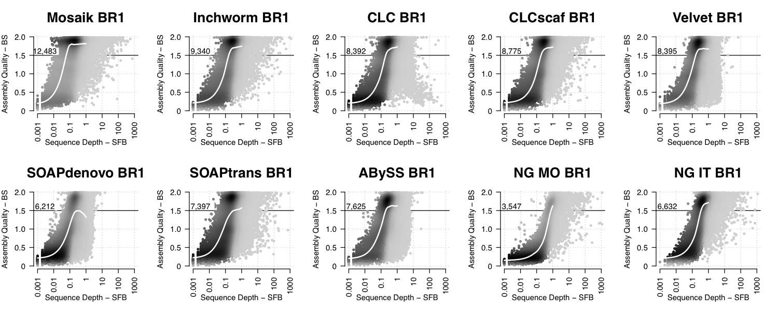

Slide 3
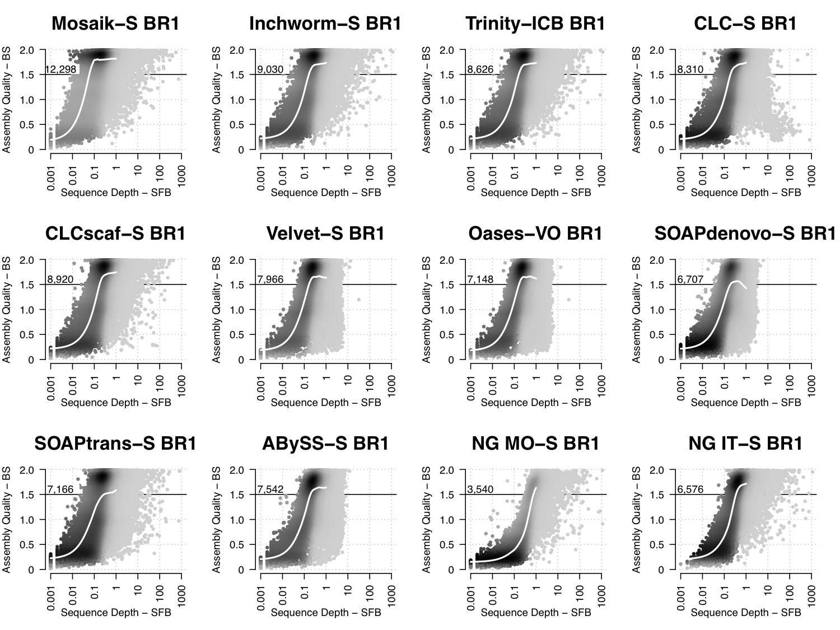

Slide 4
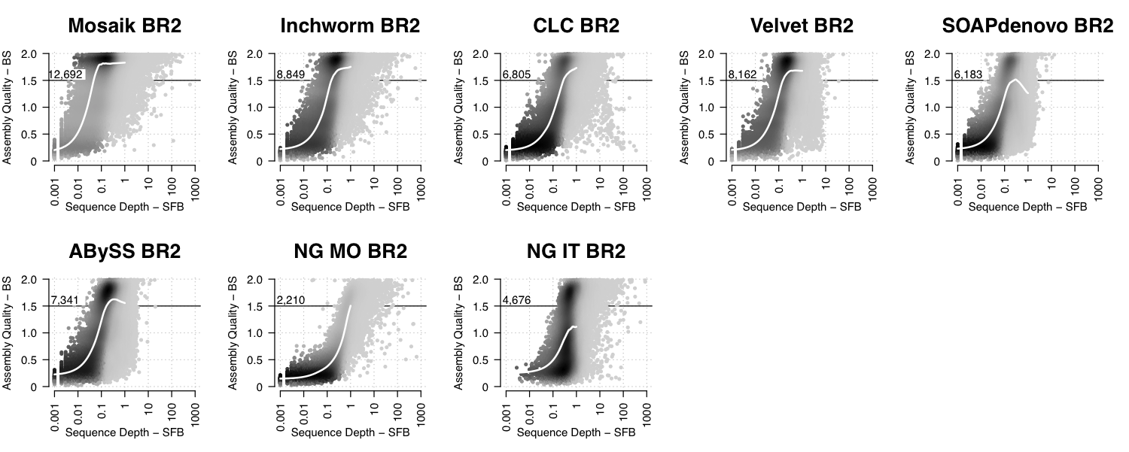

Slide 5
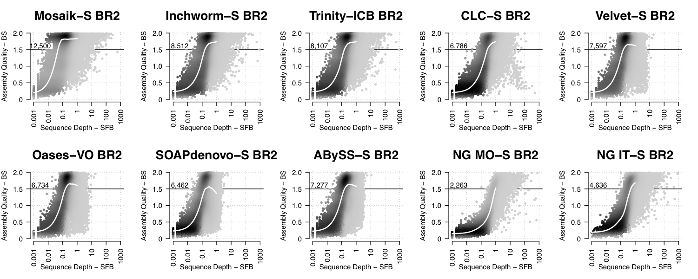

Slide 6
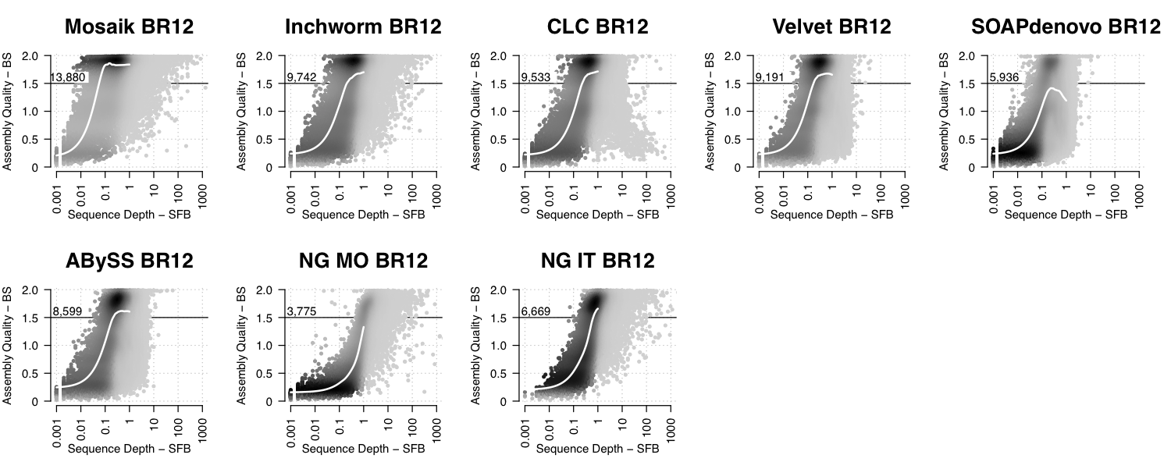

Slide 7
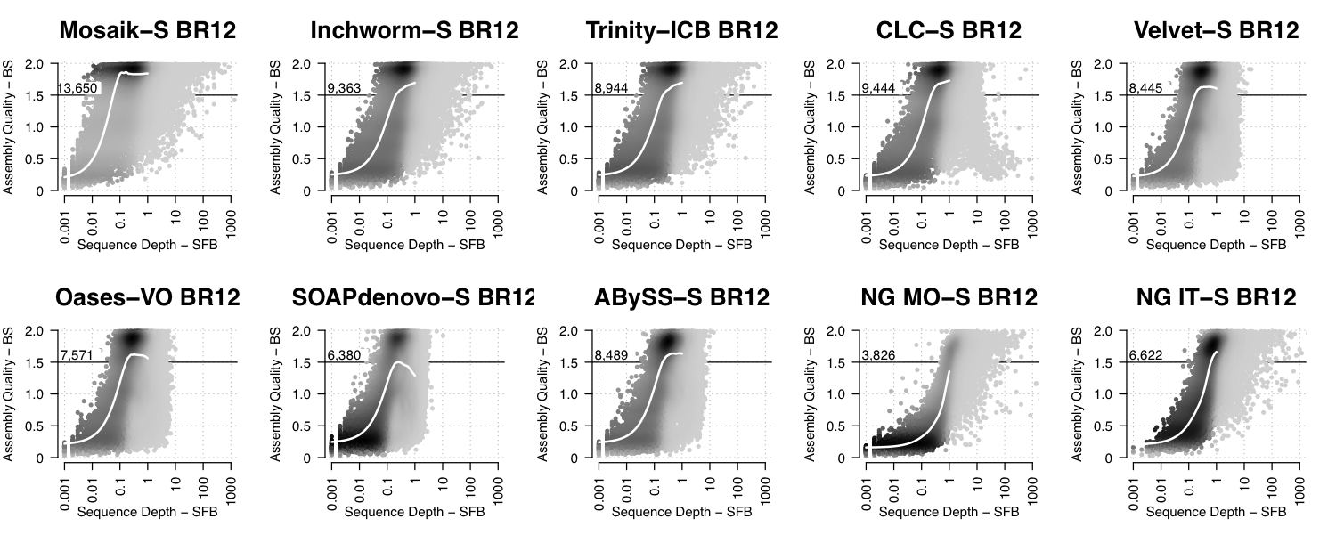

Slide 8
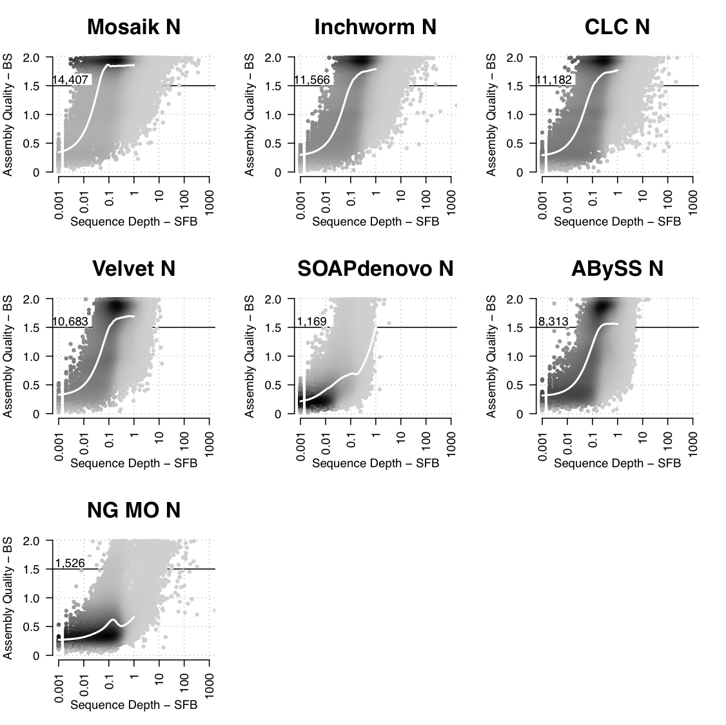

Slide 9
