Slide 1
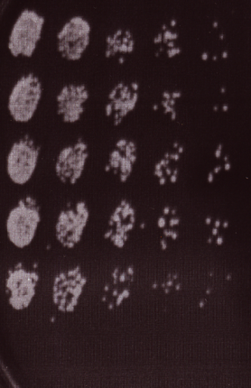
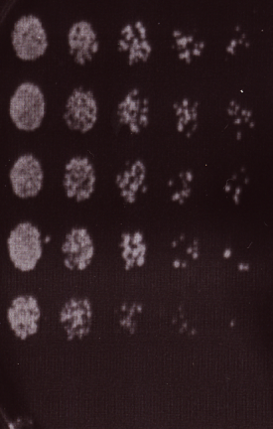
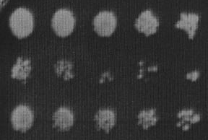
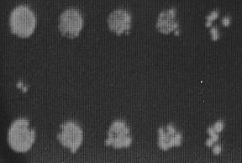
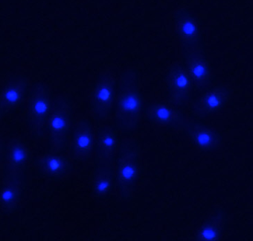
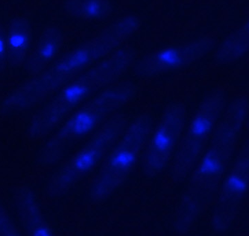
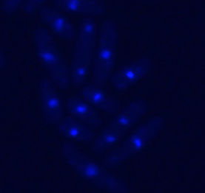
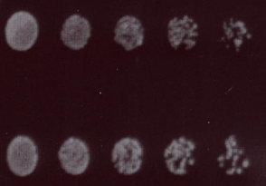
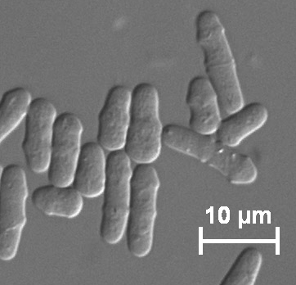
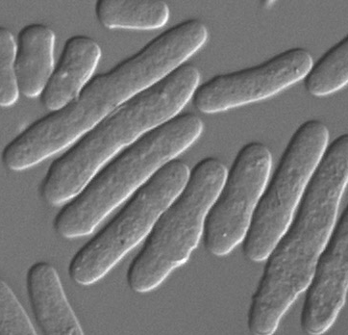
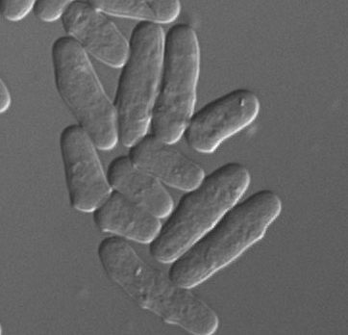
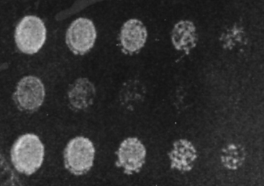
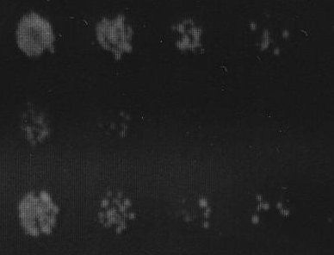
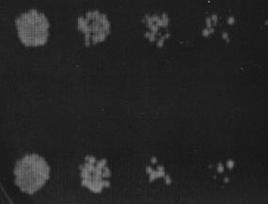
Additional file S3
A
B
Control
Control
0.01µg/ml
wt
Phleo 10μg/ml
0.1µg/ml
G418
Phleo+ 0.6M KCl
1µg/ml
Control
10µg/ml
sod2Δ
Phleo 10μg/ml
100µg/ml
Phleo+ 0.6M KCl
wt
sty1Δ
D
Control
Phleomycin
Phleomycin+ KCl
C
Control
DAPI
pzh1Δ
Phleo 10μg/ml
Phleo+ 0.6M KCl
E
DIC
Control
wt
LiCl 4 mM
pzh1Δ
LiCl+ 0.6M KCl
Control
hal4Δ
LiCl 4 mM
LiCl+ 0.6 M KCl
Control
sod2Δ
LiCl 4 mM
LiCl+ 0.6 M KCl

